Slide 1
Classroom Schedule Maker
INFO 2103 Section 02

Slide 2
Group 6
NAME | MATRIC NO
MAHANAD CHAMIE | 1625331
JAKI FAYEK ALVI RAHMAN | 1721485

Slide 3
Scenario:
Classroom schedule maker is a database that will help the lecturers,staff and students to book a classroom for various activities such as examination, discussion, revision, maintenance. Classroom can only be booked if it is not under any activity mentioned above. Schedule can be stated as starting time and ending time along with the purpose of booking.

Slide 4
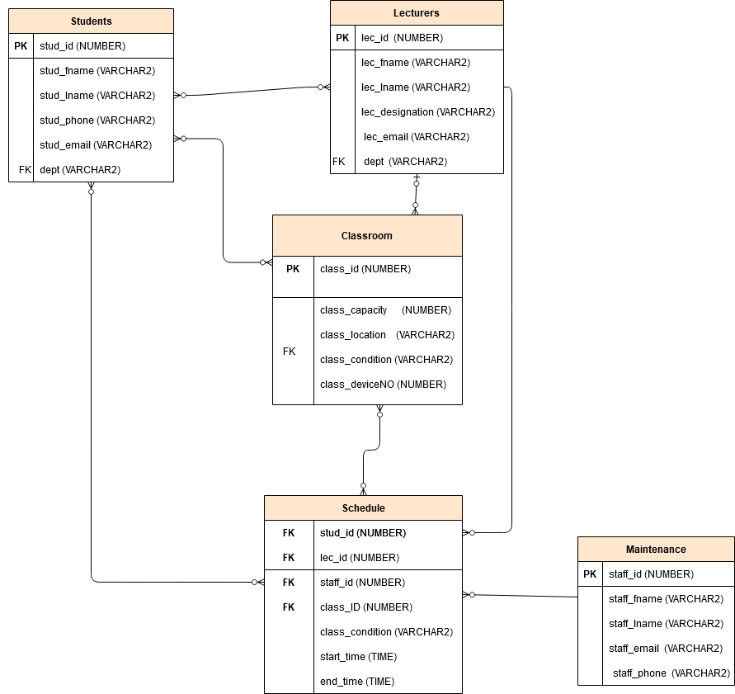
Entity Relation Diagram

Slide 5
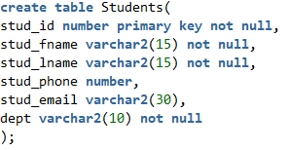
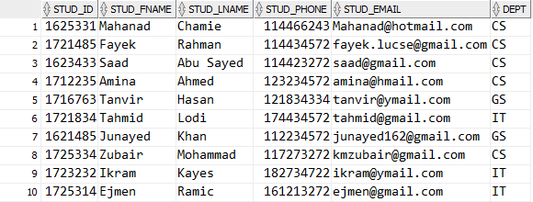
Student Table:

Slide 6
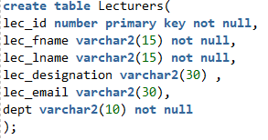
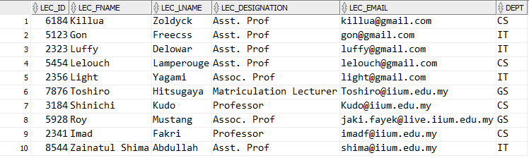
Lecturers Table

Slide 7
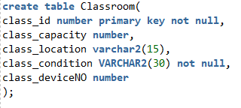
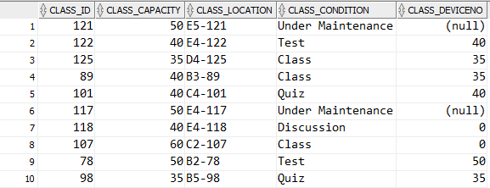
Classroom Table:

Slide 8
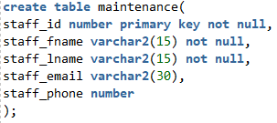
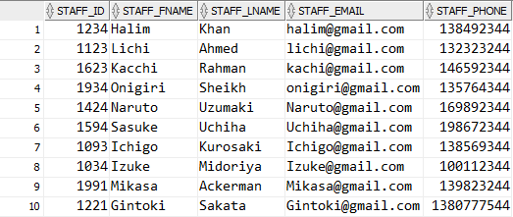
Maintenance Table:

Slide 9
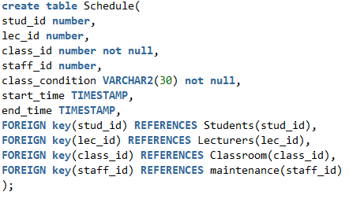
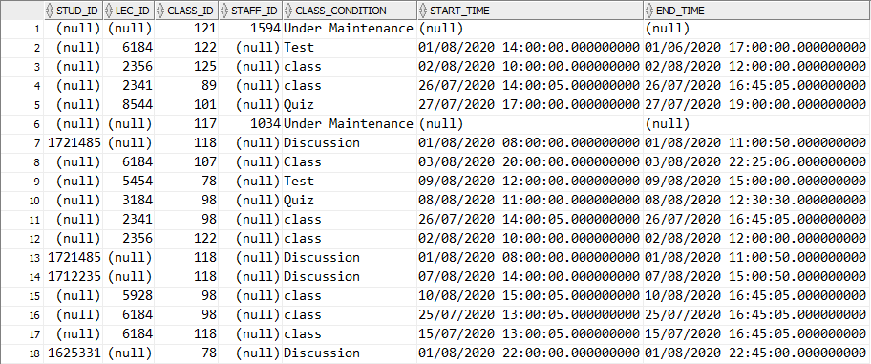
Schedule Table:

Slide 10
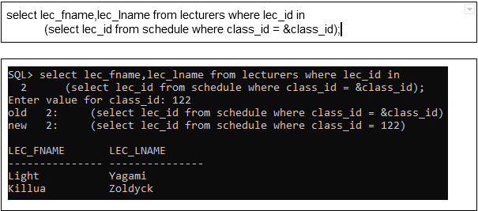
Basic Queries:
Print lecturer first name and last name that have booked a class. Prompt the user to insert class ID.

Slide 11
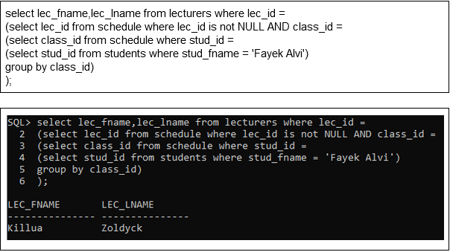
Basic Queries
Print lecture first name and last name who have booked the same classroom as the student.

Slide 12
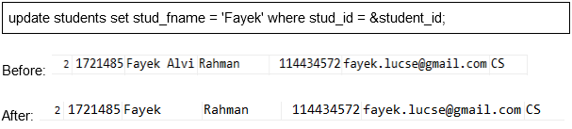
Basic Queries
Update student data by prompting user to enter student id.

Slide 13
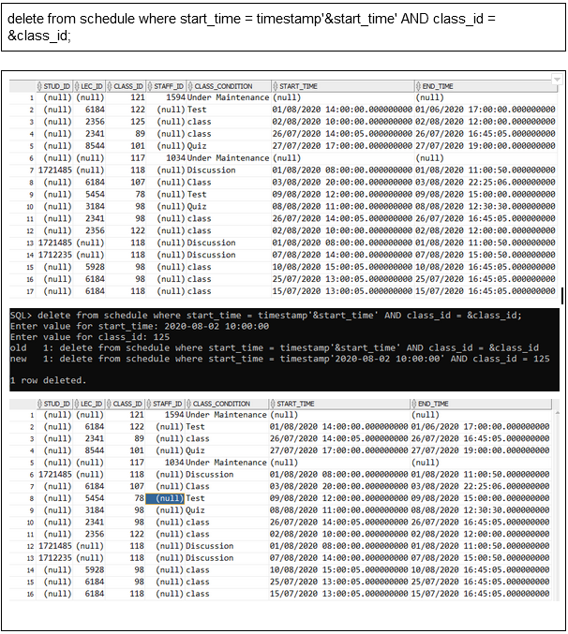
Basic Queries
Prompt the user to delete a booking by entering booking start time (YYYY-MM-DD HH24:MI:SS) and class_id.

Slide 14
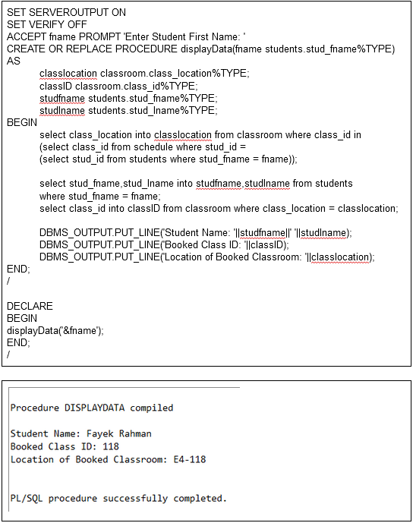
Procedures
Write a procedure to get the booked class id and location. Prompt the user to enter the student first name. Use an anonymous block to call the procedure.

Slide 15
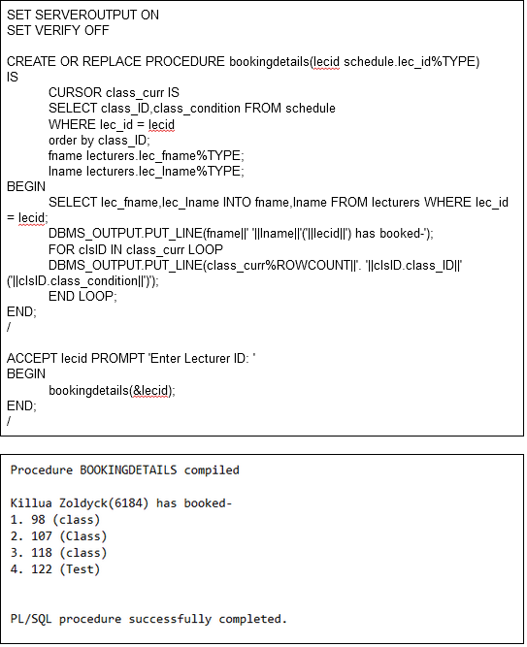
Procedures
Write a procedure to get the classroom id and booking details of a lecturer. Prompt the user to enter lecturer id. Use an anonymous block to call the procedure.

Slide 16
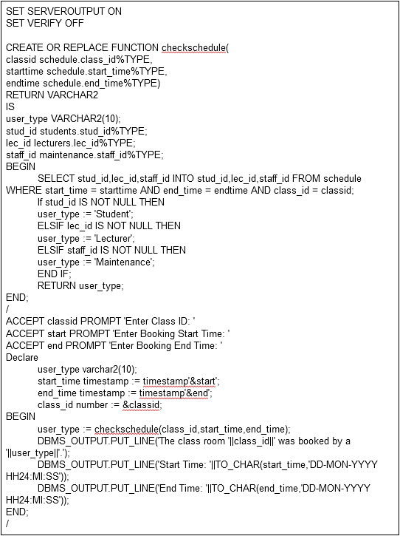
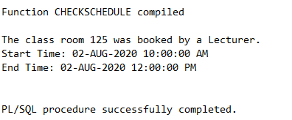
Functions:
Create a function that shows the booking details (start time, end time, classroom ID) and the schedular’s designation. Call the function from an anonymous block.

Slide 17
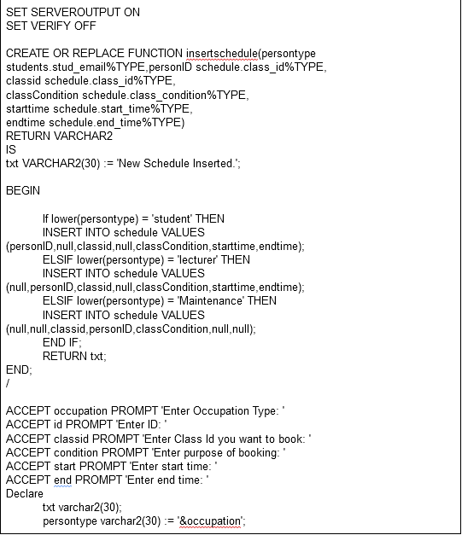
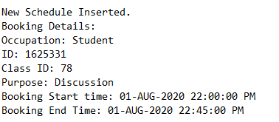
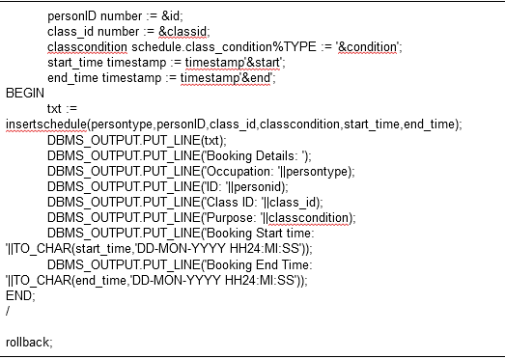
Functions:
Create a function to add a new schedule to the schedule table. Use an anonymous block to call function and enter data.

Slide 18
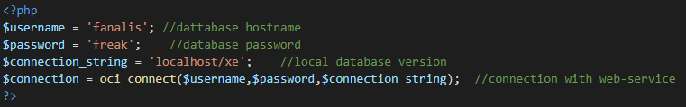
Web Application
In order to establish connection between the local database with web-service, we used php and XAMPP.
Here, username and password are the name of database host name and password .
And connection_string is the database name (ex- orcl, xe)

Slide 19
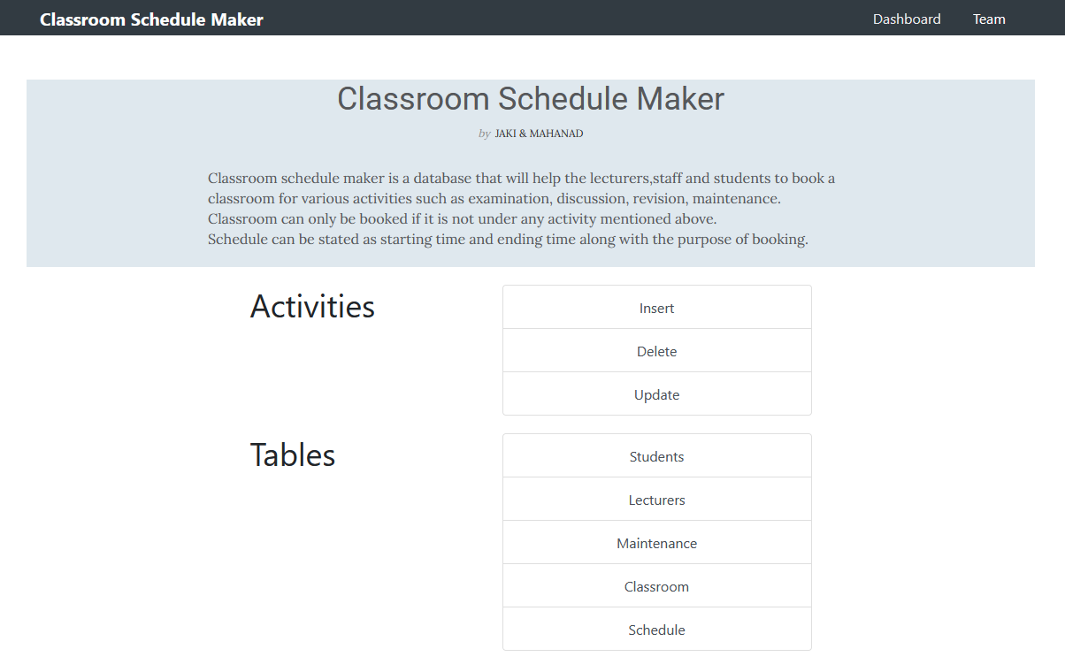
Web Application (Main Page)

Slide 20
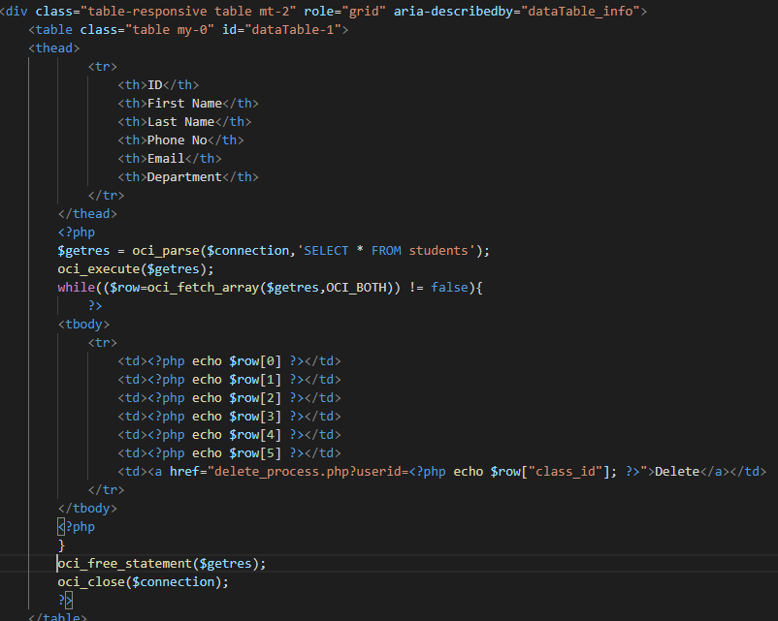
Web Application (View)

Slide 21
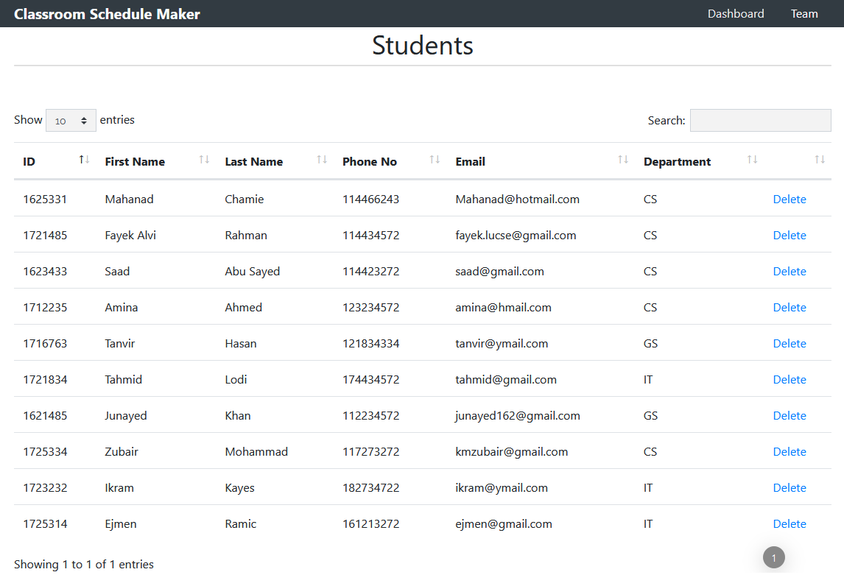
Web Application (Students Page)

Slide 22
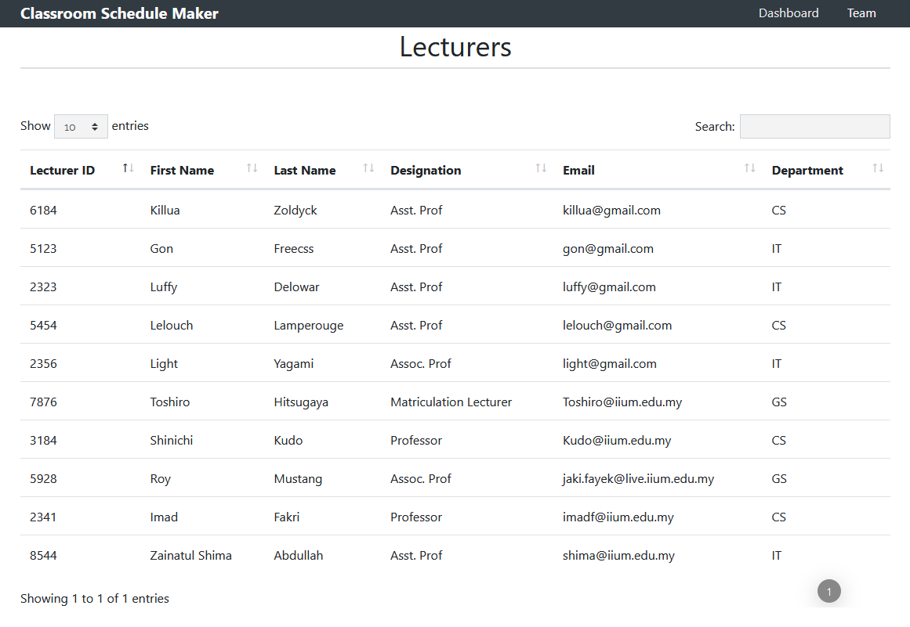
Web Application (Lecturers Page)

Slide 23
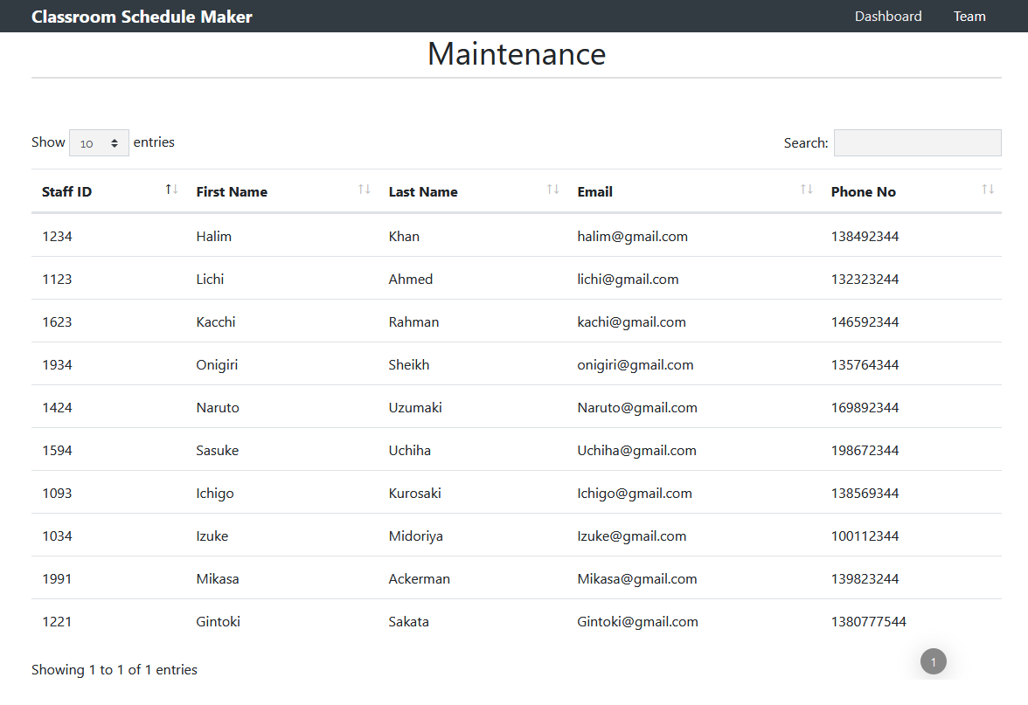
Web Application (Maintenance Page)

Slide 24
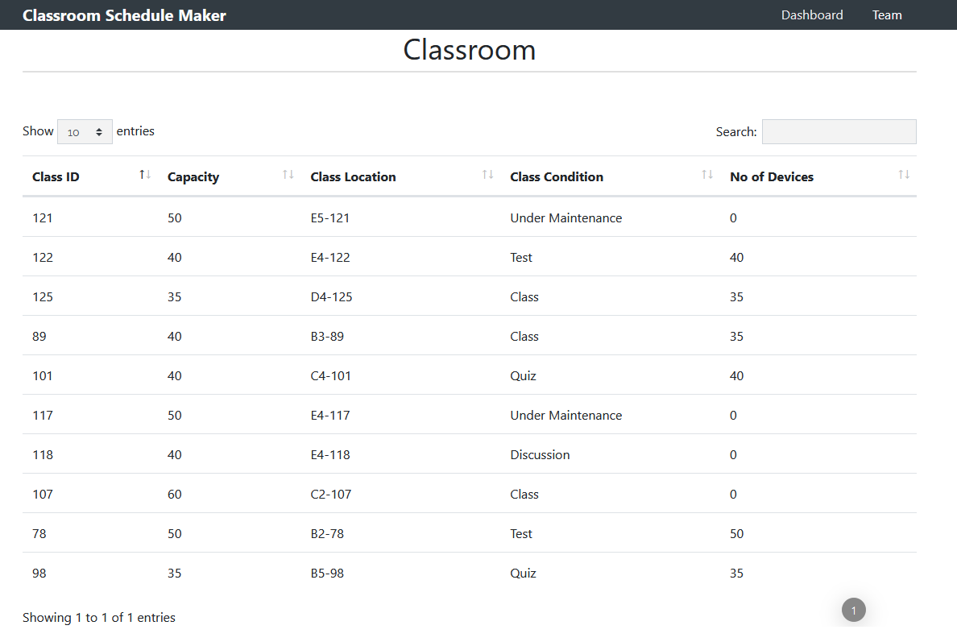
Web Application (Classroom Page)

Slide 25
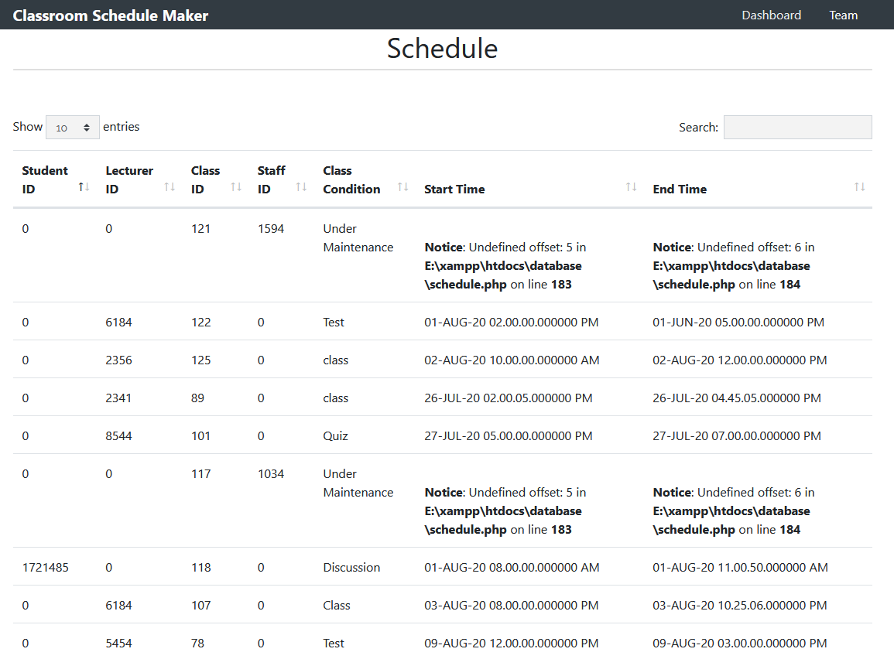
Web Application (Schedule Page)

Slide 26
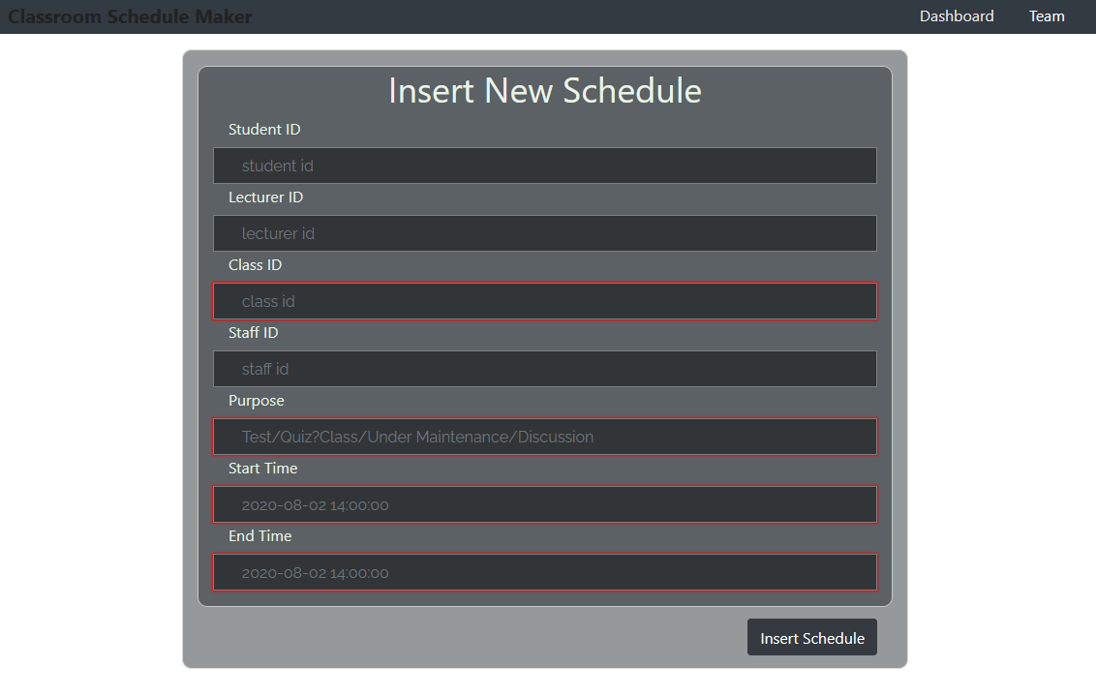
Web Application (Insert Page)

Slide 27
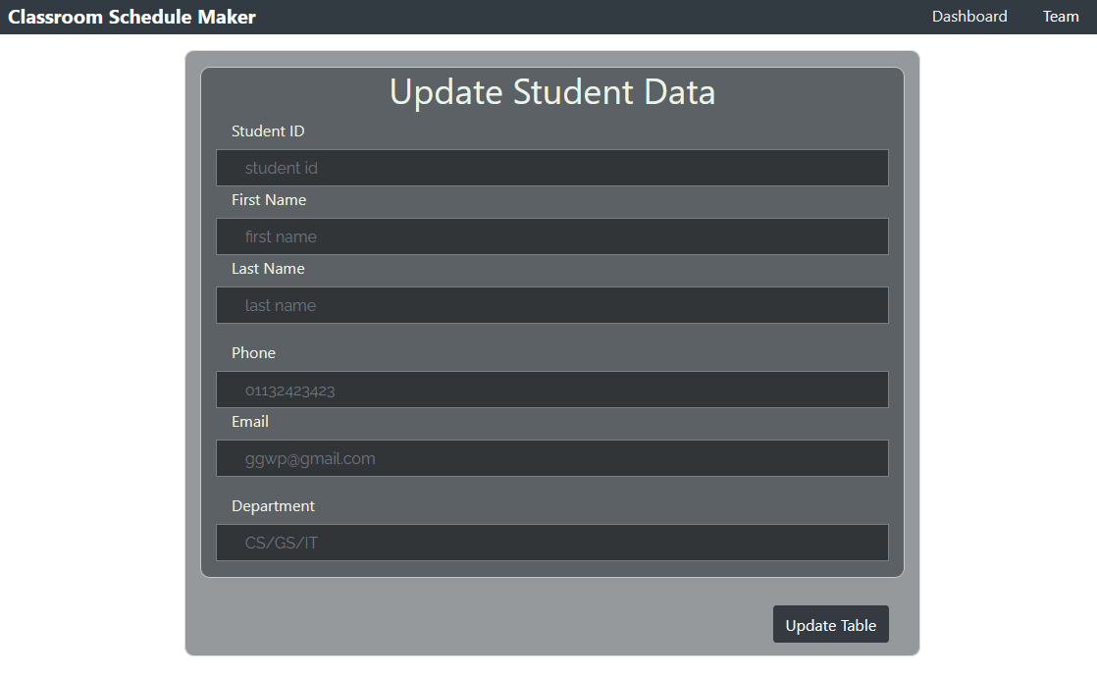
Web Application (Update Page)

Slide 28
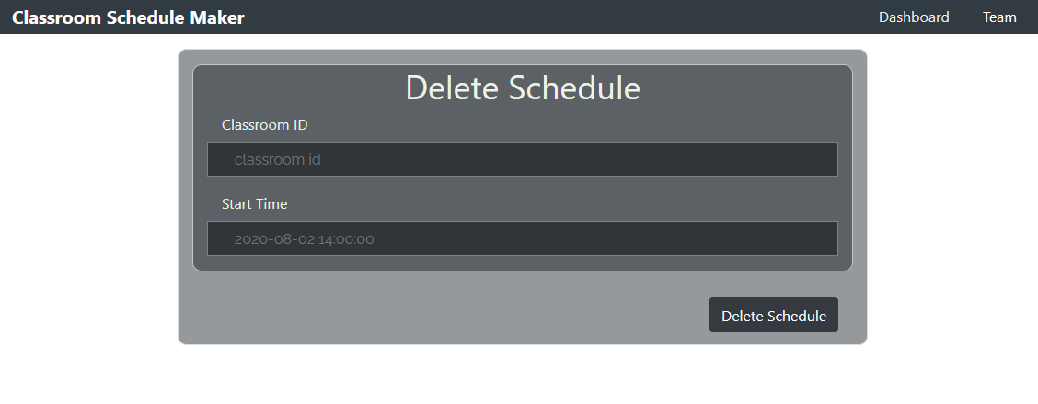
Web Application (Delete Page)

